Slide 1
Machine Learning
Artificial Neural Networks
Dr. Anil K Ahlawat
KIET Group of Institutions

Slide 2
Artificial Neural Networks
Threshold units
Gradient descent
Multilayer networks
Backpropagation
Hidden layer representations
Example: Face Recognition
Advanced topics

Slide 3
Connectionist Models (1/2)
Consider humans:
Neuron switching time ~ .001 second
Number of neurons ~ 10¹⁰
Connections per neuron ~ 10⁴⁻⁵
Scene recognition time ~ .1 second
100 inference steps doesn’t seem like enough
→ much parallel computation

Slide 4
Connectionist Models (2/2)
Properties of artificial neural nets (ANN’s):
Many neuron-like threshold switching units
Many weighted interconnections among units
Highly parallel, distributed process
Emphasis on tuning weights automatically

Slide 5
When to Consider Neural Networks
Input is high-dimensional discrete or real-valued
(e.g. raw sensor input)
Output is discrete or real valued
Output is a vector of values
Possibly noisy data
Form of target function is unknown
Human readability of result is unimportant
Examples:
Speech phoneme recognition [Waibel]
Image classification [Kanade, Baluja, Rowley]
Financial prediction

Slide 6
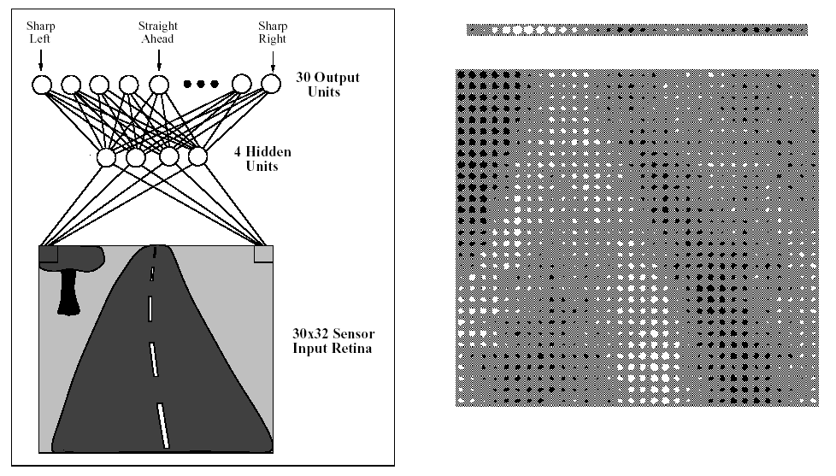
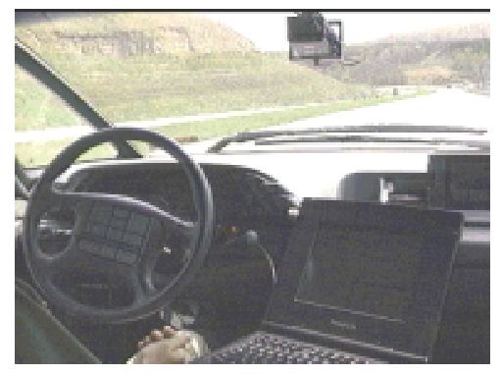
ALVINN drives 70 mph on highways

Slide 7
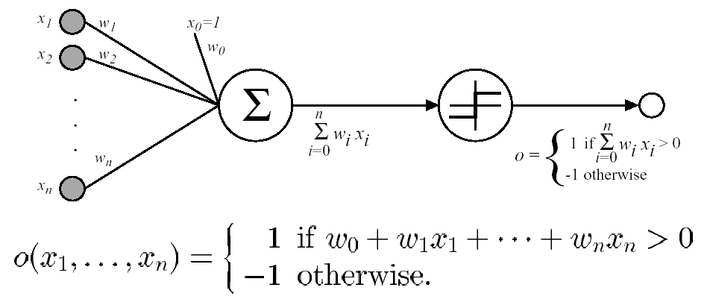
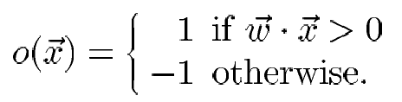
Perceptron
Sometimes we’ll use simpler vector notation:

Slide 8
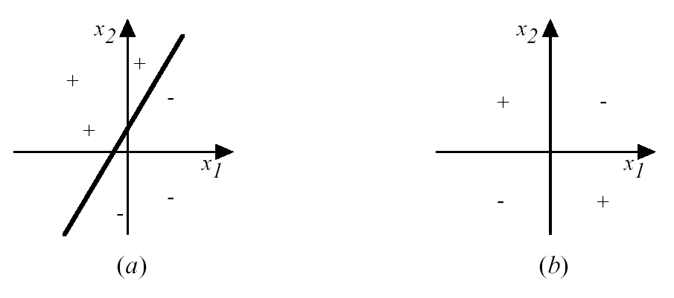
Decision Surface of a Perceptron
Represents some useful functions
What weights represent
g(x₁, x₂) = AND(x₁, x₂)?
But some functions not representable
e.g., not linearly separable
Therefore, we’ll want networks of these...

Slide 9
Perceptron training rule
w_{i} ← w_{i} + Δw_{i}
where Δw_{i} = η (t – o) x_{i}
Where:
t = c(x) is target value
o is perceptron output
η is small constant (e.g., .1) called learning rate
Can prove it will converge
If training data is linearly separable
and η sufficiently small

Slide 10
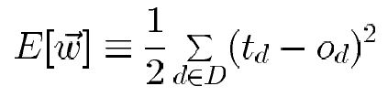
Gradient Descent (1/4)
To understand, consider simpler linear unit, where
o = w₀ + w₁x₁ + ··· + w_{n}x_{n}
Let's learn w_{i}’s that minimize the squared error
Where D is set of training examples

Slide 11
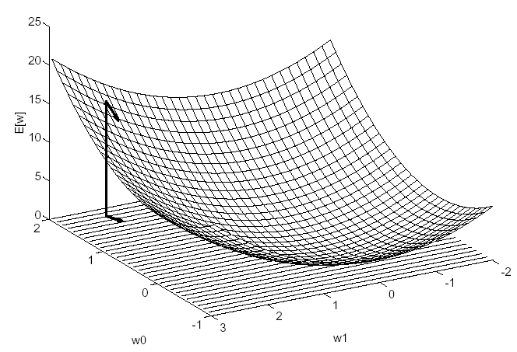
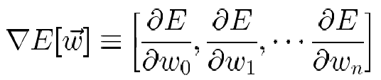
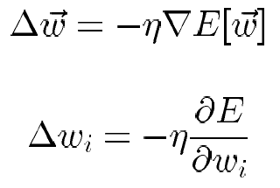
Gradient Descent (2/4)
Gradient
Training rule:
i.e.,

Slide 12
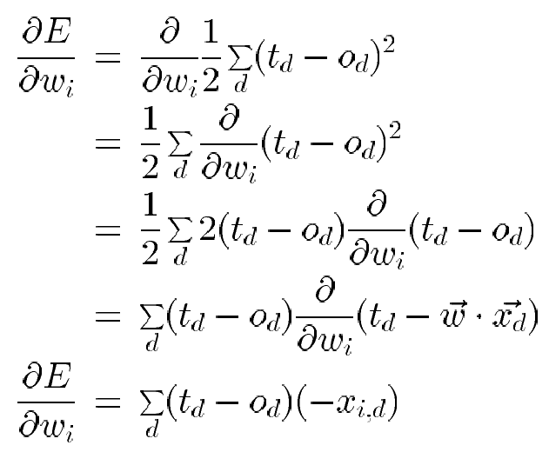
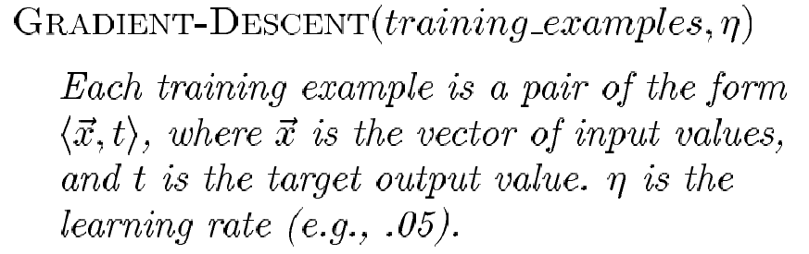
Gradient Descent (3/4)

Slide 13
Gradient Descent (4/4)
Initialize each w_{i} to some small random value
Until the termination condition is met, Do
  Initialize each Δw_{i} to zero.
  For each <x, t> in training_examples, Do
  * Input the instance x to the unit and compute the output o
  * For each linear unit weight w_{i}, Do
Δw_{i} ← Δw_{i} + η (t – o) x_{i}
  For each linear unit weight w_{i} , Do
w_{i} ← w_{i} + Δw_{i}

Slide 14
Summary
Perceptron training rule guaranteed to succeed if
Training examples are linearly separable
Sufficiently small learning rate η
Linear unit training rule uses gradient descent
Guaranteed to converge to hypothesis with minimum squared error
Given sufficiently small learning rate η
Even when training data contains noise
Even when training data not separable by H

Slide 15
Incremental (Stochastic) Gradient Descent (1/2)
Batch mode Gradient Descent:
Do until satisfied
1. Compute the gradient E_{D}[w]
2. w ← w - η E_{D}[w]
Incremental mode Gradient Descent:
Do until satisfied
For each training example d in D
1. Compute the gradient E_{d}[w]
2. w ← w - η E_{d}[w]

Slide 16
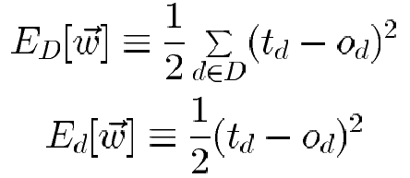
Incremental (Stochastic) Gradient Descent (2/2)
Incremental Gradient Descent can approximate Batch Gradient Descent arbitrarily closely if η made small enough

Slide 17
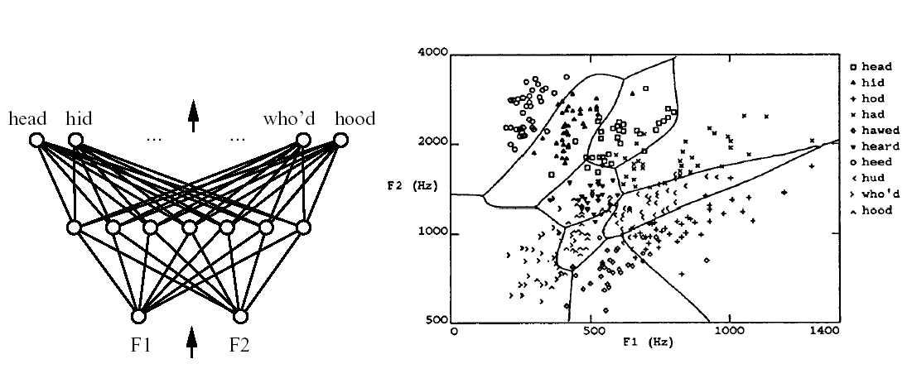
Multilayer Networks of Sigmoid Units

Slide 18
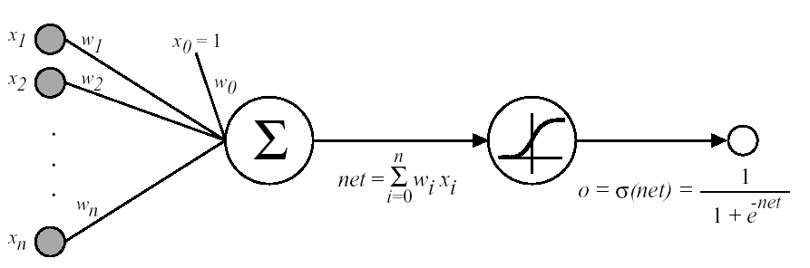


Sigmoid Unit
σ(x) is the sigmoid function
Nice property:
We can derive gradient decent rules to train
One sigmoid unit
Multilayer networks of sigmoid units → Backpropagation

Slide 19
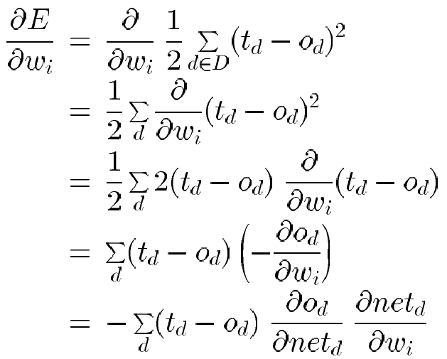
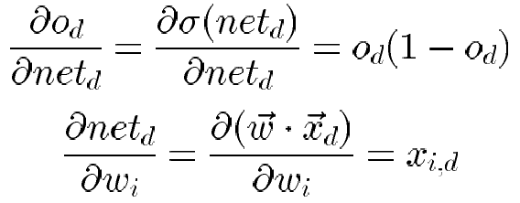
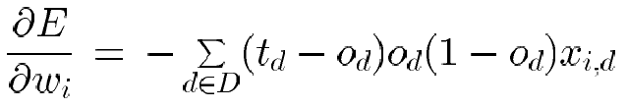
Error Gradient for a Sigmoid Unit
But we know:
So:

Slide 20
Backpropagation Algorithm
Initialize all weights to small random numbers. Until satisfied, Do
For each training example, Do
1. Input the training example to the network and compute the
network outputs
2. For each output unit k : δ_{k} ← ο_{k}(1 - ο_{k}) (t_{k} - ο_{k})
3. For each hidden unit h
δ_{h} ← ο_{h}(1 - ο_{h}) _{k ∈outputs} w_{h,k}δ_{k}
4. Update each network weight w_{i,j}
w_{i,j} ← w_{i,j} + Δw_{i,j}
where Δw_{i,j} = η δ_{j} x_{i,j}
Σ

Slide 21
More on Backpropagation
Gradient descent over entire network weight vector
Easily generalized to arbitrary directed graphs
Will find a local, not necessarily global error minimum
  In practice, often works well (can run multiple times)
Often include weight momentum α
Δw_{i,j} (n) = η δ_{j} x_{i,j} + α Δw_{i,j} (n - 1)
Minimizes error over training examples
  Will it generalize well to subsequent examples?
Training can take thousands of iterations → slow!
Using network after training is very fast

Slide 22
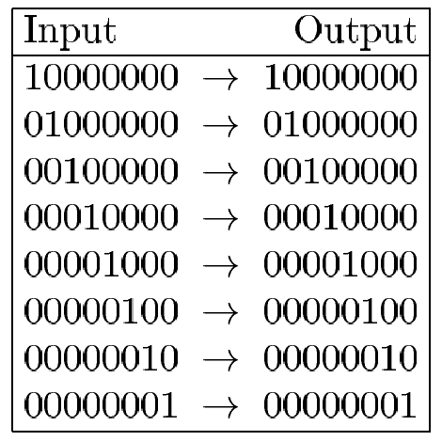
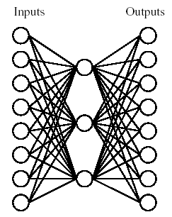
Learning Hidden Layer Representations (1/2)
A target function:
Can this be learned??

Slide 23
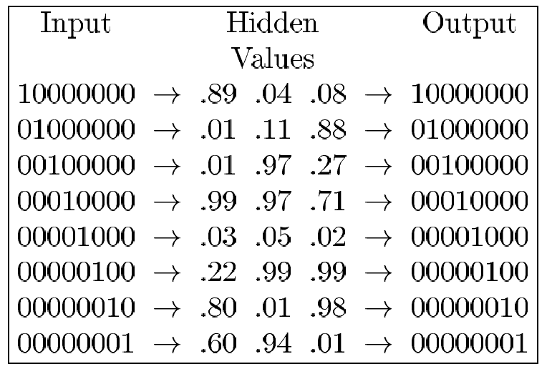
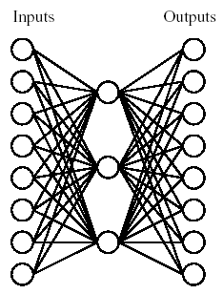
Learning Hidden Layer Representations (2/2)
A network:
Learned hidden layer representation:

Slide 24
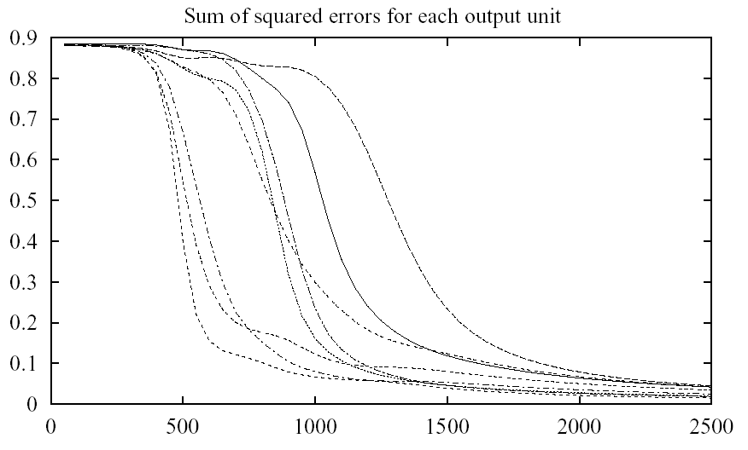
Training (1/3)

Slide 25
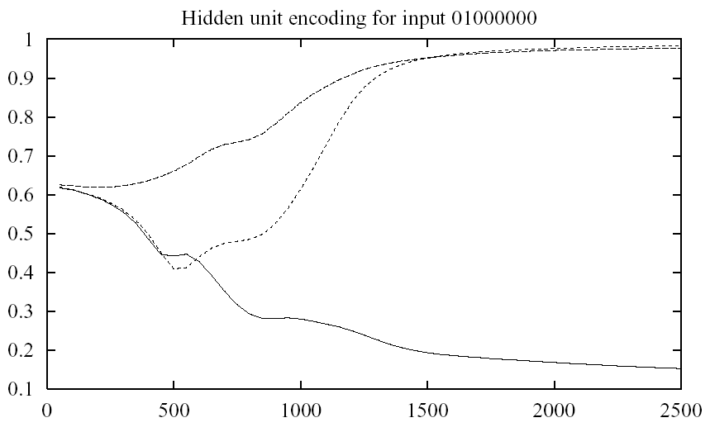
Training (2/3)

Slide 26
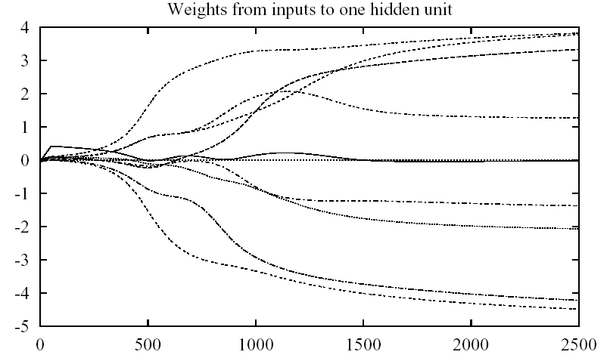
Training (3/3)

Slide 27
Convergence of Backpropagation
Gradient descent to some local minimum
Perhaps not global minimum...
Add momentum
Stochastic gradient descent
Train multiple nets with different initial weights
Nature of convergence
Initialize weights near zero
Therefore, initial networks near-linear
Increasingly non-linear functions possible as training progresses

Slide 28
Expressive Capabilities of ANNs
Boolean functions:
Every boolean function can be represented by network with single hidden layer
but might require exponential (in number of inputs) hidden units
Continuous functions:
Every bounded continuous function can be approximated with arbitrarily small error, by network with one hidden layer [Cybenko 1989; Hornik et al. 1989]
Any function can be approximated to arbitrary accuracy by a network with two hidden layers [Cybenko 1988].

Slide 29
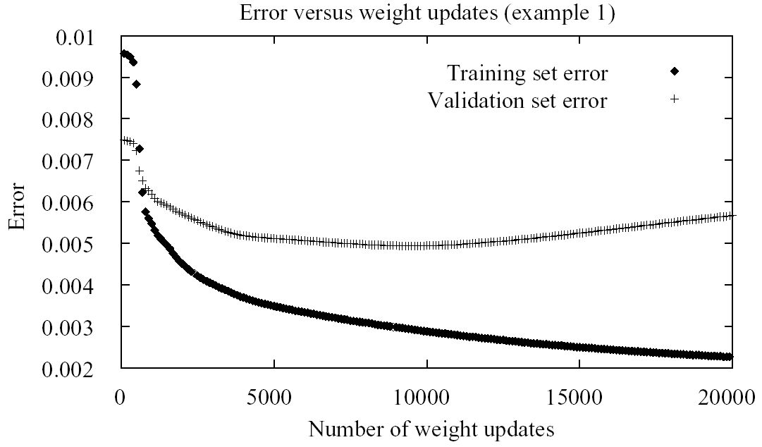
Overfitting in ANNs (1/2)

Slide 30
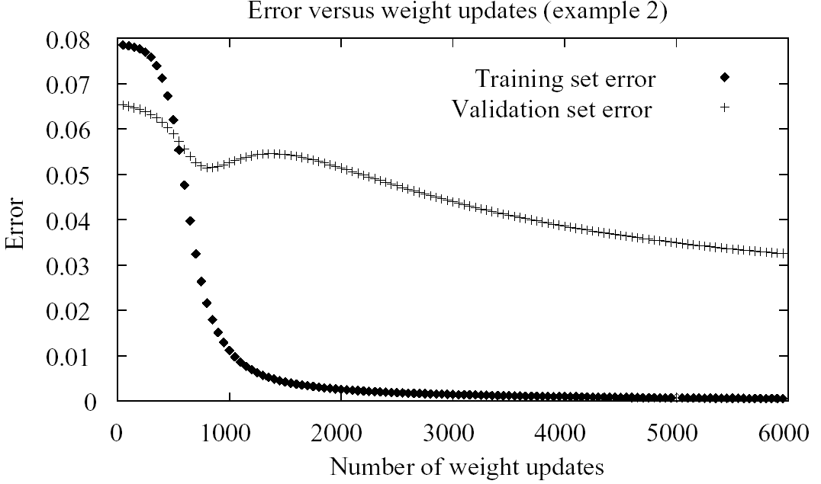
Overfitting in ANNs (2/2)

Slide 31
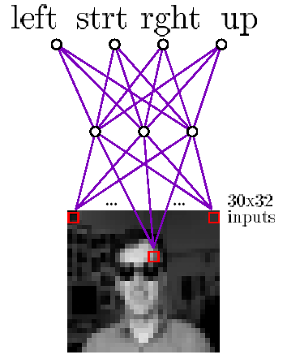
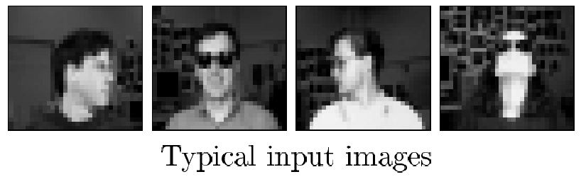
Neural Nets for Face Recognition
90% accurate learning head pose, and recognizing 1-of-20 faces

Slide 32
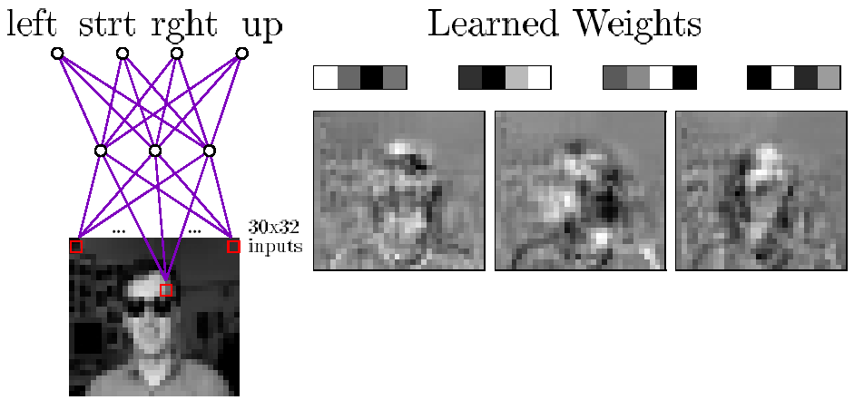
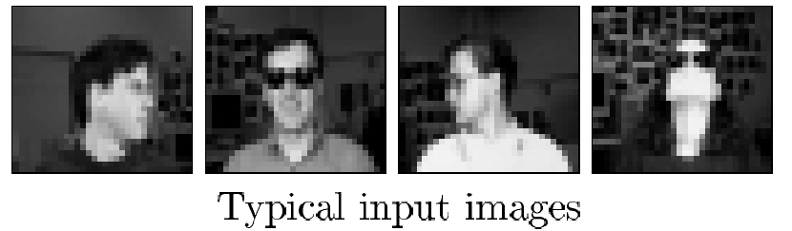
Learned Hidden Unit Weights
http://www.cs.cmu.edu/tom/faces.html

Slide 33
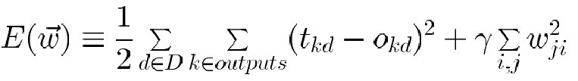
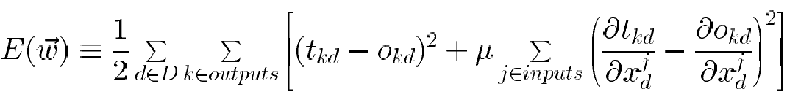
Alternative Error Functions
Penalize large weights:
Train on target slopes as well as values:
Tie together weights:
e.g., in phoneme recognition network

Slide 34
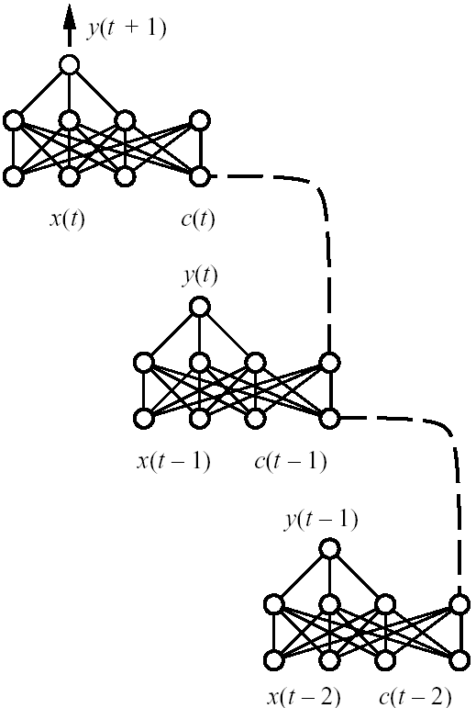
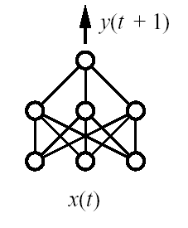
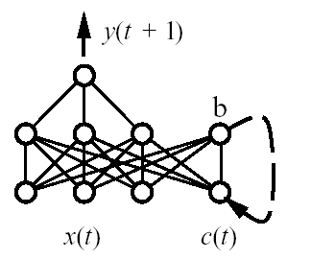
Recurrent Networks
(a)
(b)
(c)
Feedforward network
Recurrent network
Recurrent network unfolded
in time

